Slide 1


WWW.JOIN.BUILD
[Project Name]
Project Kickoff Workshop
Notes:
You can replace the background image with a rendering or photo from the actual project for a more personalized touch

Slide 2

BEFORE WE START
Using This Resource
Let’s Get This Project Started
Starting a project off on the right foot is key to overall success of the project. That's why we created this template to help you ensure every project is set up for success
With that said, this document and its linked resources are here to guide you on that journey. Once you’ve personalized it to your specific needs, you can use it to facilitate your project kickoff workshop and teach Project Admins the initial setup and how to successfully use Join throughout the project.
We’ve set up this document to be easily personalized. Throughout, you’ll see italicized text like this that is designed to be instructional. Any text in brackets [ ] is intended to be changed with company-specific information, e.g. [Project Name]. You’ll also find guidance and talking points in the speaker notes.
Notes:
Once you’ve customized your template, this slide can be removed

Slide 3


TABLE OF CONTENTS
Introductions
Workshop
Agenda
Join Refresher
Workshop Framework
Let’s get Busy
Keys to Project Success

Slide 4

INTRODUCTIONS
Project Team
Notes:
Ask the Project Team to introduce themselves, remember they may not have met you or members of the team. It's always good to ask them to share their comfort level Join (this will let you know if they’ve done their homework) a gentle reminder of the training plan is always a good fit here
Also ask one of them to give an overview of the project, location, type of project, phase, project partners, construction value etc. again everyone may not be aware of these facts

Slide 5

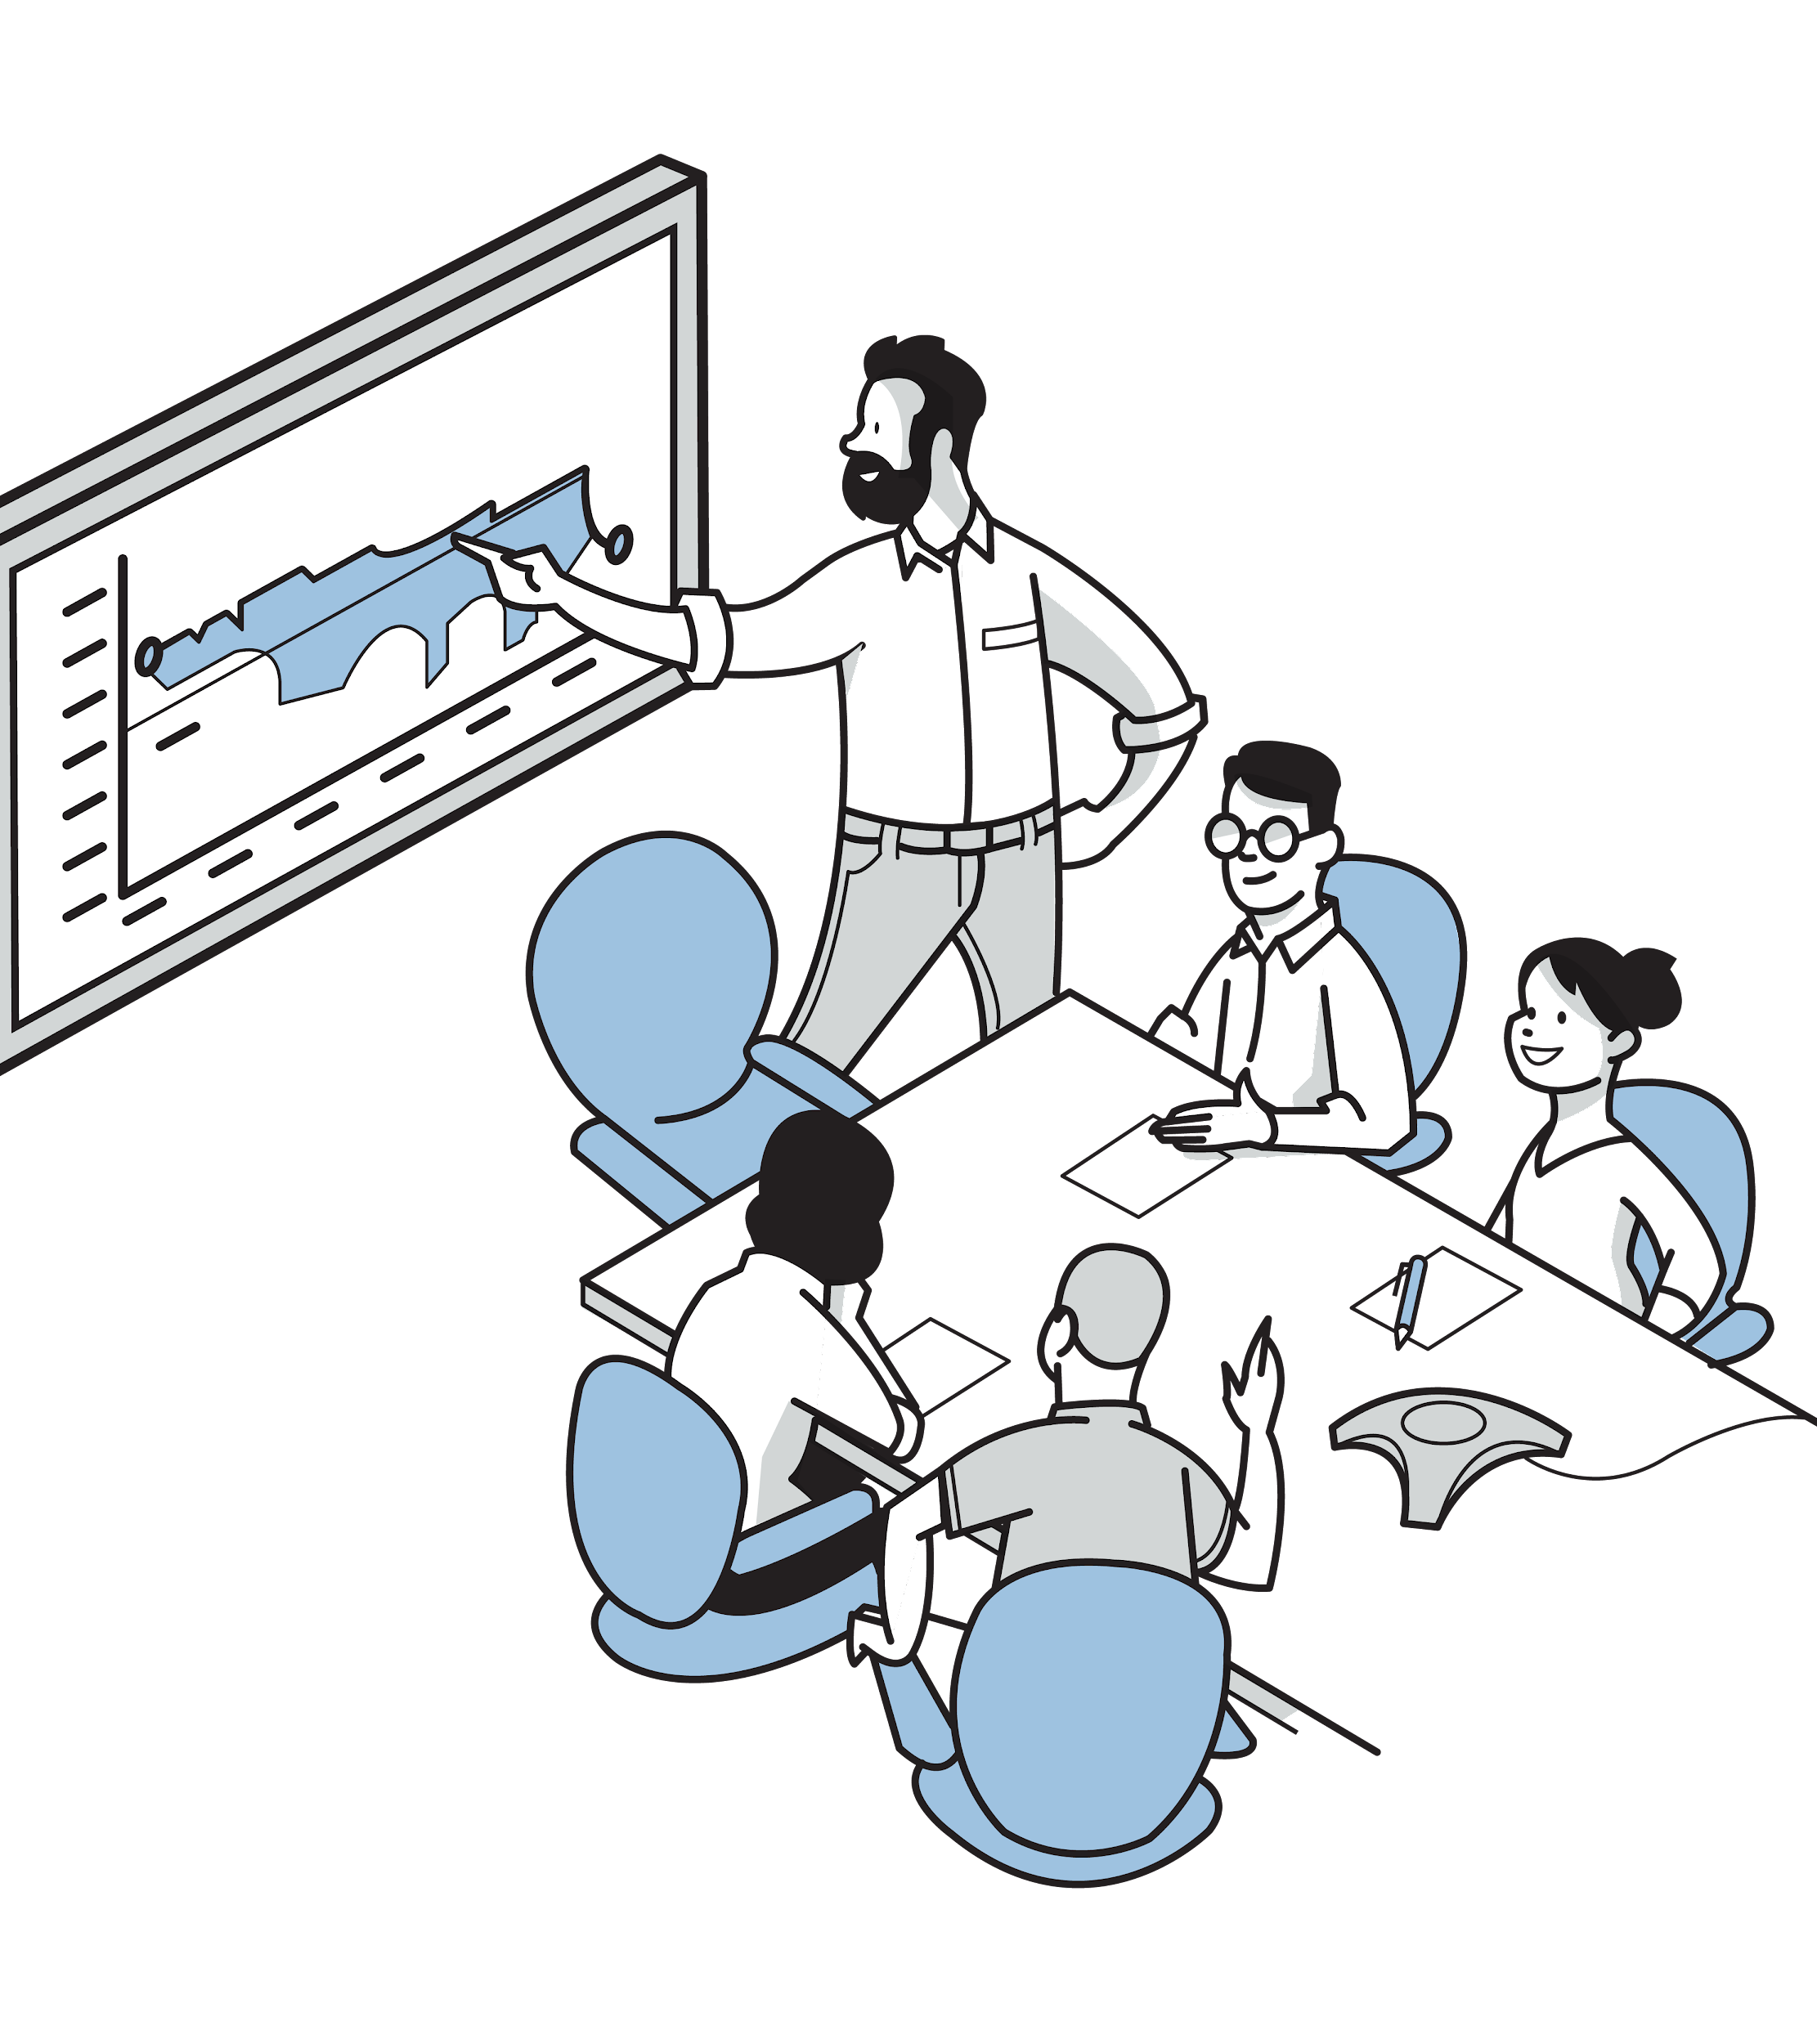
JOIN ONBOARDING
Your Join Team
[Input Name] - Executive Sponsor
[Input Name] - Join Lead
[Input Name] - Join Champion
[Input Name] - Join Champion
[Input Name] - Join Champion
Notes:
Remind them of the Join team who has been put together to support the rollout of Join, this helps the project team feel supported but also know this isn’t something the company is taking lightly. We’ve included the roll definitions below in case you need them
Executive Sponsor
Has a vested interest in seeing Join successfully rolled out across your organization, but will not be involved in the day-to-day activities of the onboarding.
Join Lead
Is responsible for moving the onboarding process forward and holds the Join Champions accountable. Serves as the primary point of contact for Join.
Join Champion
The critical resource for the success of Join within your organization. They will be responsible for actively participating in the onboarding process and becoming a Join product expert. They are accountable for driving adoption & providing guidance internally.

Slide 6
JOIN REFRESHER
Why We Chose Join
Desired Outcome
Business Opportunity
1
[Problem 1]
[Opportunity 1]
2
[Problem 2]
[Opportunity 2]
3
[Problem 3]
[Opportunity 3]
Notes:
Copy your company goals from the Messaging Plan, it helps to remind the project team what is in it for them

Slide 7

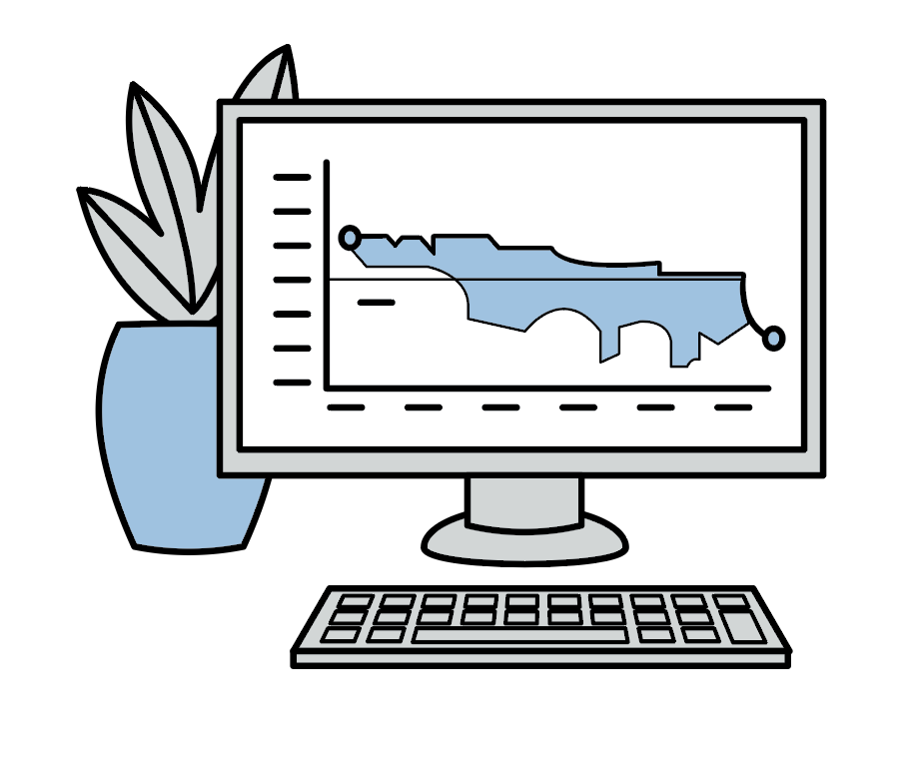
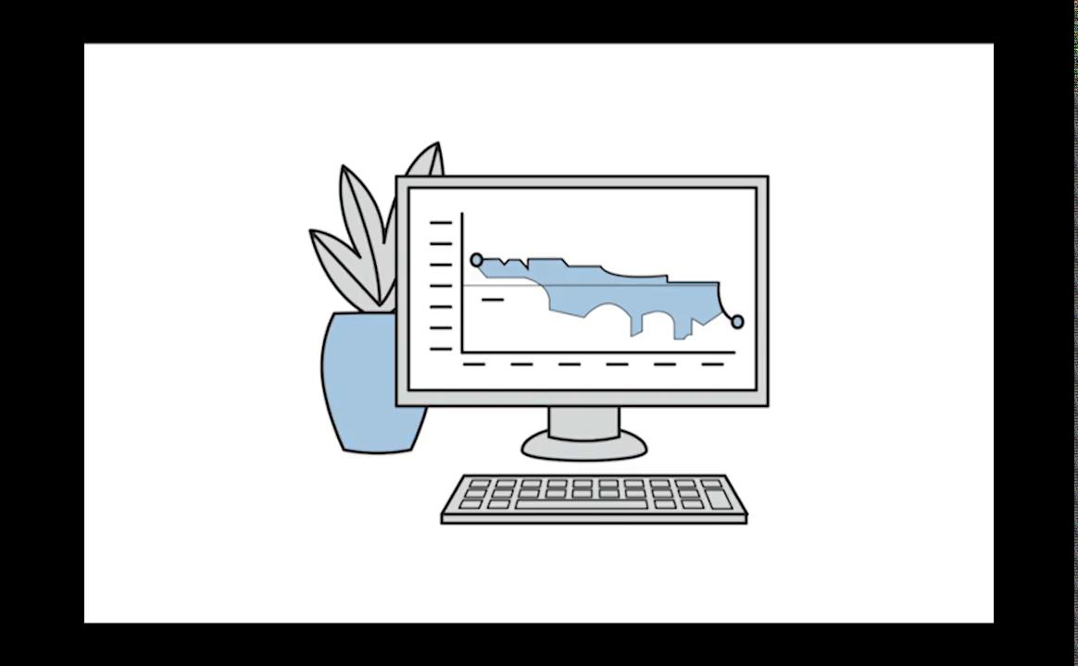
JOIN REFRESHER
Join Overview
Join transforms the preconstruction experience by enabling the entire project team to drive decisions through shared information and real-time communication.
Notes:
If everyone has done their homework, you can skip this slide, otherwise a quick refresher is always good.

Slide 8


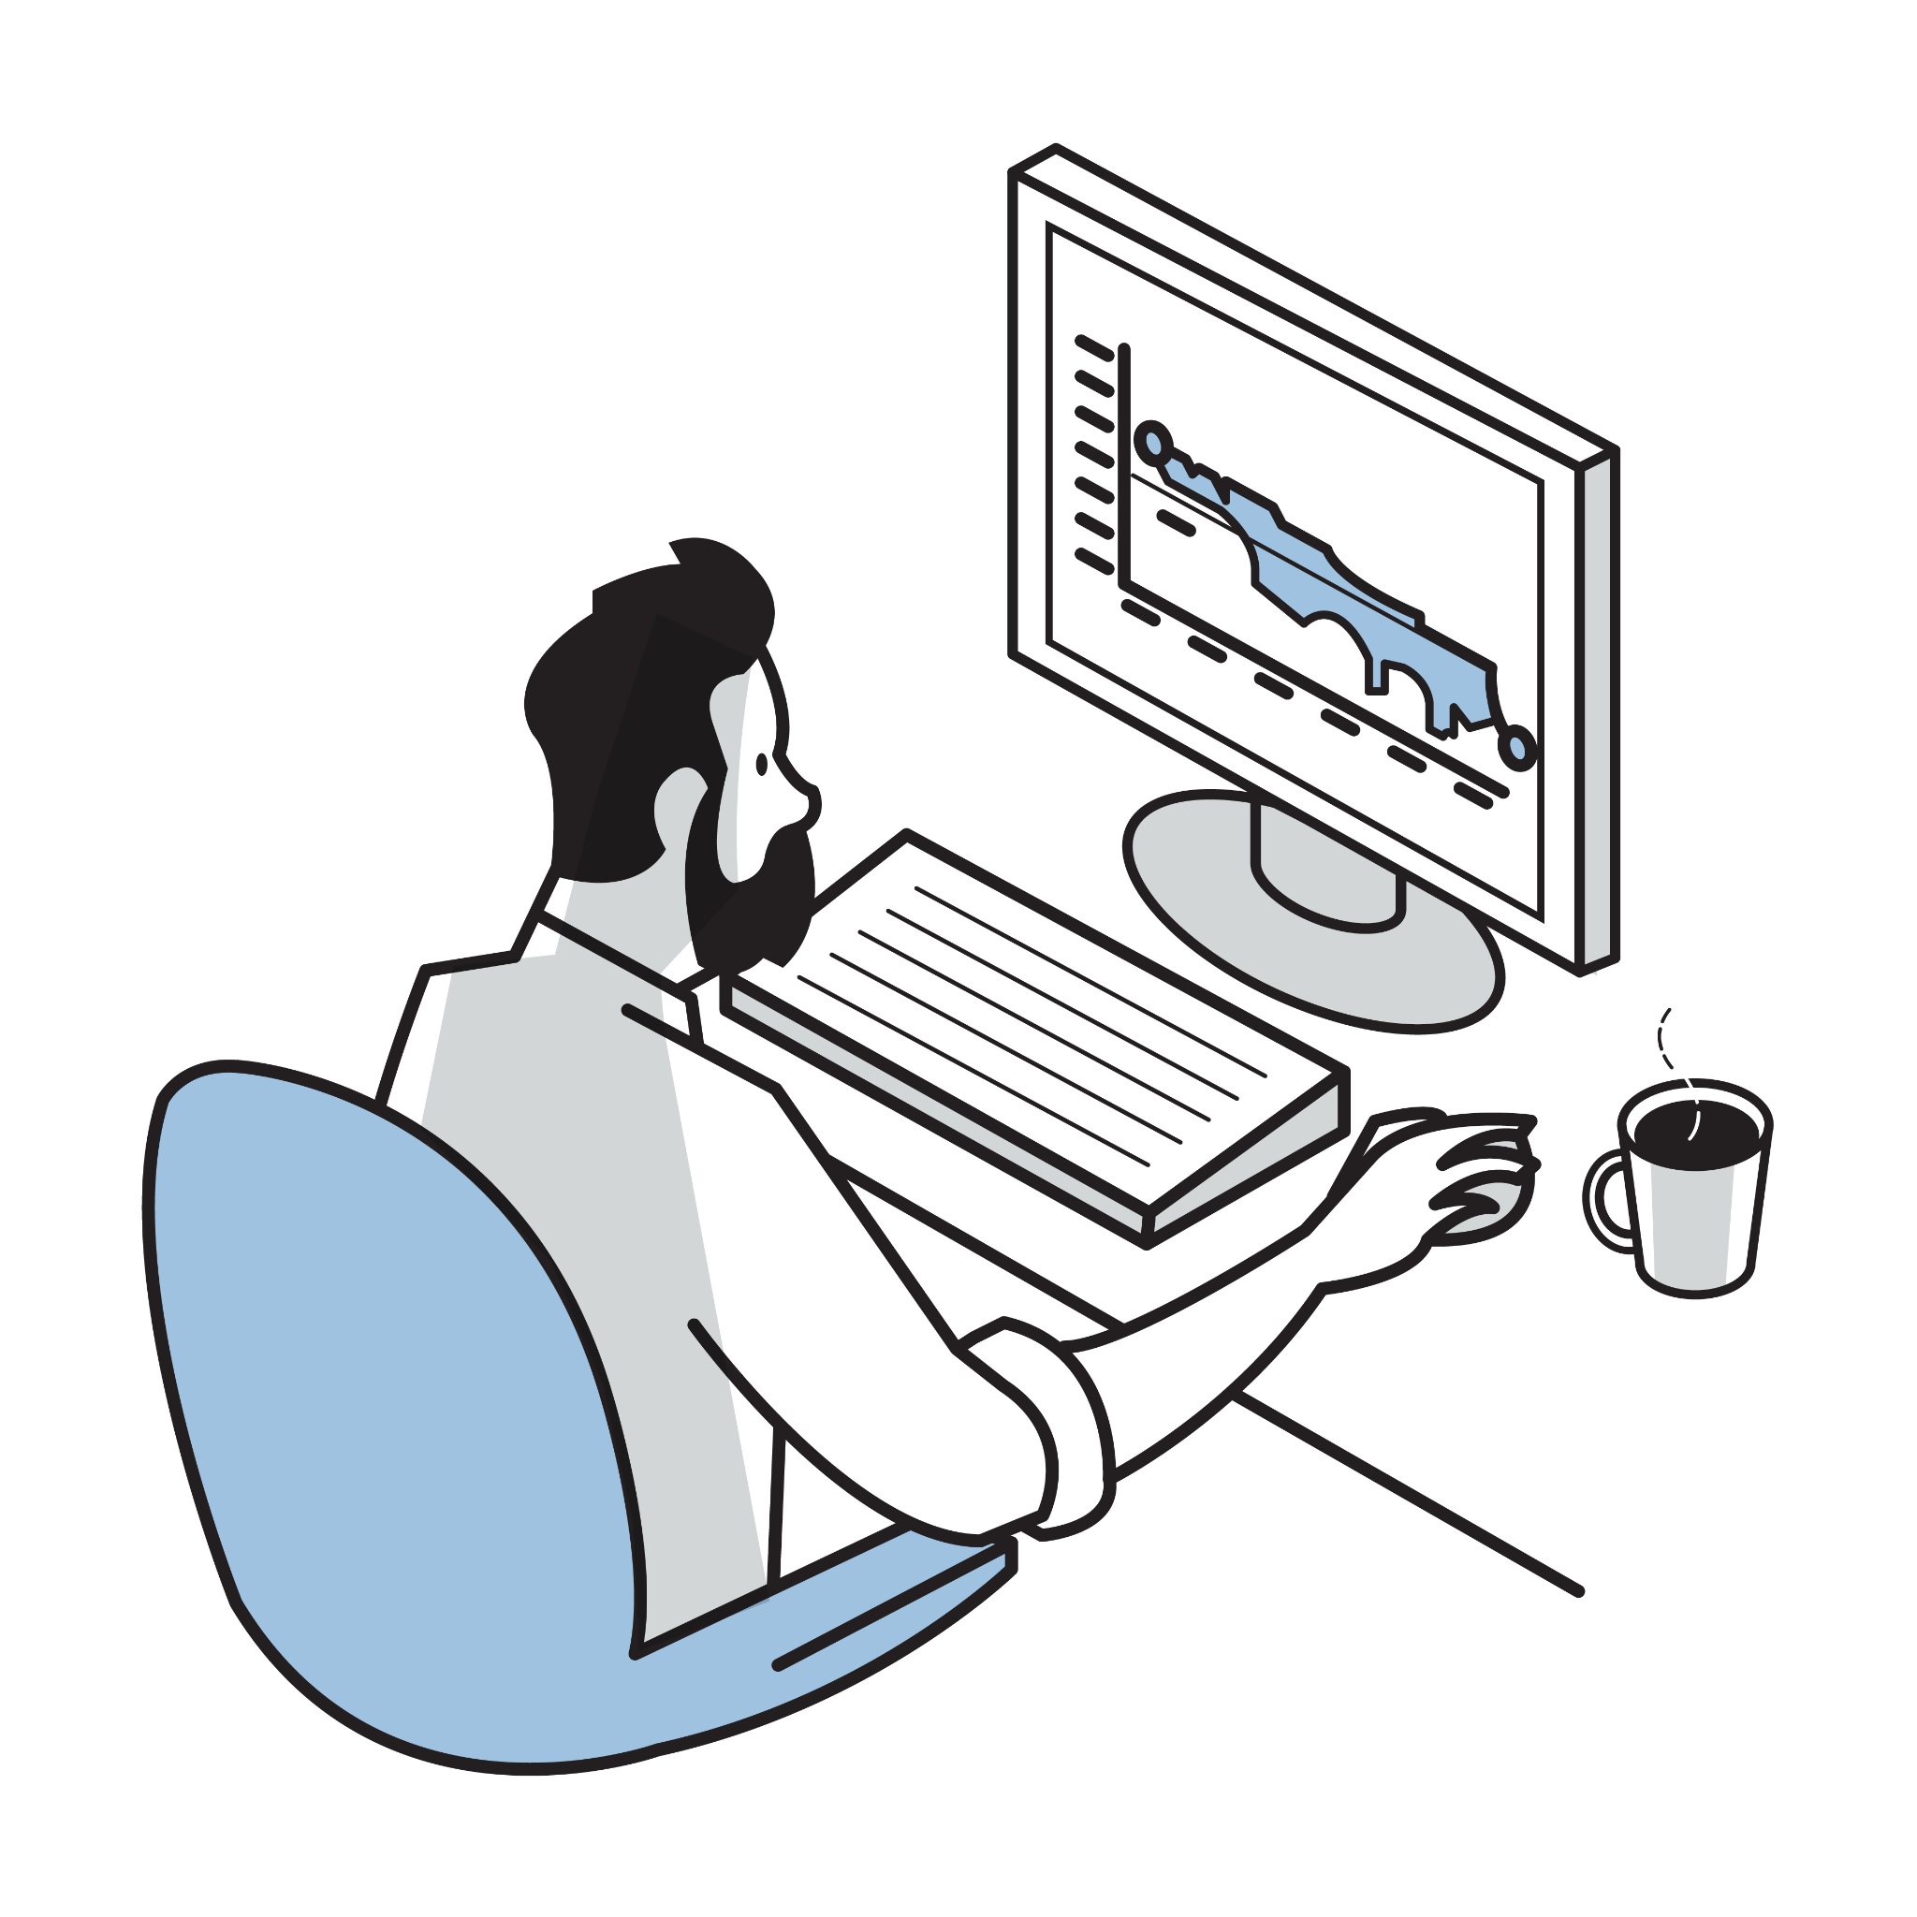
PROJECT QUICKSTART GUIDE
Workshop Framework
1
2
3
4
INVITE
CREATE
IMPORT
ADD
Create the project in Join.
Enter project details.
Edit terminology and units of measure.
Add project team logos.
Import your first estimate into Join.
Add a ROM budget.
Create addition WBS and categories based on company standards.
Build out your change log in Join.
Setup a default Item template.
Add Items for potential cost changes.
Check out the Dashboard to see how this project is trending.
Invite as many team members as suitable for project needs.
Let the team know whats coming.
Configure Role permissions.
Preview what they see
to ensure it's correct.
*Workshop is typically completed in 3-4 hours depending on your project complexity
Notes:
Explain the steps they’ll walk through during the workshop. This is a good chance to see if they brought all the prerequisites.

Slide 9
LET’S GET BUSY
Let’s This Project Started
Notes:
Click the image to launch Join

Slide 10

CREATE
Project Setup
Sign Up
If you don’t have a Join account go to app.join.build and follow instructions to sign up. Check your email, you’ll need to validate your account.
Create a new Project
Click the + New Project button in the top right of the projects screen after you log in. If you just created an account, you’ll be directed to create your first project.
Add Project Info
Fill in a project description, select your relevant units of measure, and update terminology. Don’t worry we’ll get to the other items later.
Tip: Add an image of the project, to give a quick visual reference when selecting your project from the projects screen.

Slide 11

IMPORT
Upload Your Estimate
Create Custom Categories
Add any additional WBS or categorizations not included in your estimate file
Import your Estimate File
Grab your estimate and import it into your first Milestone. If importing from your estimating software we’ll guide you through mapping the estimate data to categories.
Tip: Only import the columns you’ll need to categorize the data.
Add your Budget
If not included as part of the Estimate import, add a ROM budget so that you can track cost trends towards your team's target.
Tip: We recommend adding a budget for relevant UniFormat or MasterFormat level 1.
Notes:
Tip: Join supports standard CSI Uniformat 2010 and CSI MasterFormat 2016. If you use a customized version of these you won’t be able to use the built in columns, no worries, when importing the data just create new columns such as Company Name MF and Company Name UF.

Slide 12

ADD
Build Your
Change Log
Setup a Default Item Template
Configure what Categorization is displayed by default when creating an Item to ensure the project team completes.
Add Your Ideas
Got idea for cost opportunities? Add them as Items, along with relevant information such as description, relevant files, and cost. These items are the foundation of Join throughout the project.
Tip: Got multiple ideas for the same idea, use Options to easily track them in a single Item.
Check out the Dashboard
This is where the power of Join really starts to show. Now you’ve added an estimate, a budget, and items you start to see how your project costs are trending.
Tip: As the project progresses and you add more Milestones use the Variance Report on the Milestones tab to compare changes in detail.

Slide 13

INVITE
Collaborate with your Project Team
Configure Role Permissions
In 90% of cases the default role permissions will suffice. Use the Role preview to explore how each role will experience Join and adjust permissions as necessary.
Tip: You can limit any person with Subcontractor role to only be able to edit costs for their trade based on any categorizations on Items.
Let Them Know What is Coming
Use our Project Team Messaging and Email templates to set expectations for the project team on how you will be using Join on the project and what is in it for them.
Invite Collaborators
Now everyone is up to speed and knows what is expected of them, invite your project team and get collaborating in Join.
Notes:
Tip: Join supports standard CSI Uniformat 2010 and CSI MasterFormat 2016. If you use a customized version of these you won’t be able to use the built in columns, no worries, when importing the data just create new columns such as Company Name MF and Company Name UF. Note

Slide 14



COMMUNICATION PLAN
Where to go for Help
?
‍
General Questions
Not sure how to do something in Join? Or want to know if you should use Join in for a certain situation?
Ask your Join Champions, they’ll have the information you need. If not they can always ask your Join Success team for backup.
Technical Support
Join is not working as you expected? Or you received an error message and you’re not sure what to do next?
Use the Contact Support form on the Join Success Hub and one of Join’s Support team will reach out to help.
Additional Learning
Want to learn more about Join? Or Need a refresher on what you learned last month?
Head on over to the Join Success Hubs Training Center for short feature videos and technical deep dives.
Feature Enhancements
Got ideas for how to make Join better? Or Wish Join did something that would make your day easier?
Join wants to hear them all. Submit ideas your ideas to the User Voice form. Join review and prioritize them regularly with our Join team.

Slide 15

ENSURE SUCCESS
Join’s Keys to Project Success
1. Use Join to run your OAC meetings
Make Join the center of your OAC meetings and record real-time decisions by tagging Items with the meeting and adding comments to the Item Change History.
2. Bring Project Partners to the table
Join is even more effective when all project partners collaborate together. Invite collaborators into the project, assign them Items and even @mention in the comments.
3. Provide supporting information right in Join
Add any supporting models, drawings, or spec sheets directly to Items to ensure your project team has all the information they need at hand to make the right decisions.
4. Check out the Join Success Hub
Join provides an ever-growing set of resources, including helpful articles and educational videos, enabling users to find their way around Join and overcome any challenges they run face.

Slide 16
Thank You!
Additional Resources
🚀 Getting Started with Join
🎬 Introduction to Join (5 mins)
🎬 Join Walkthrough (37 mins)
📚 Join Success Center
💬 Join Technical Support

