Slide 1


WWW.JOIN.BUILD
[Project Name]
How we’re using Join
Notes:
Replace the background image with one of the project

Slide 2

BEFORE WE START
Using This Resource
Let’s Get This Project Started
Starting a project off on the right foot is key to overall success of the project. That's why we created this template to help you ensure every project is set up for success
With that said, this document and its linked resources are here to guide you on that journey. Once you’ve personalized it to your specific needs, you can use it to facilitate your project kickoff workshop and communicate expectations to the project team ahead of time.
Don’t forget the Workshop Facilitator Guide to help you navigate the workshop
We’ve set up this document to be easily personalized. Throughout, you’ll see italicized text like this that is designed to be instructional. Any text in brackets [ ] is intended to be changed with company-specific information, e.g. [Project Name]. You’ll also find guidance and talking points in the speaker notes.

Slide 3


TABLE OF CONTENTS
Project Team Intro
Agenda
Core Join Functions
Item Lifecycle
Keys to Project Success

Slide 4

INTRODUCTIONS
Project Team
Notes:
Add project team logos to this slide

Slide 5

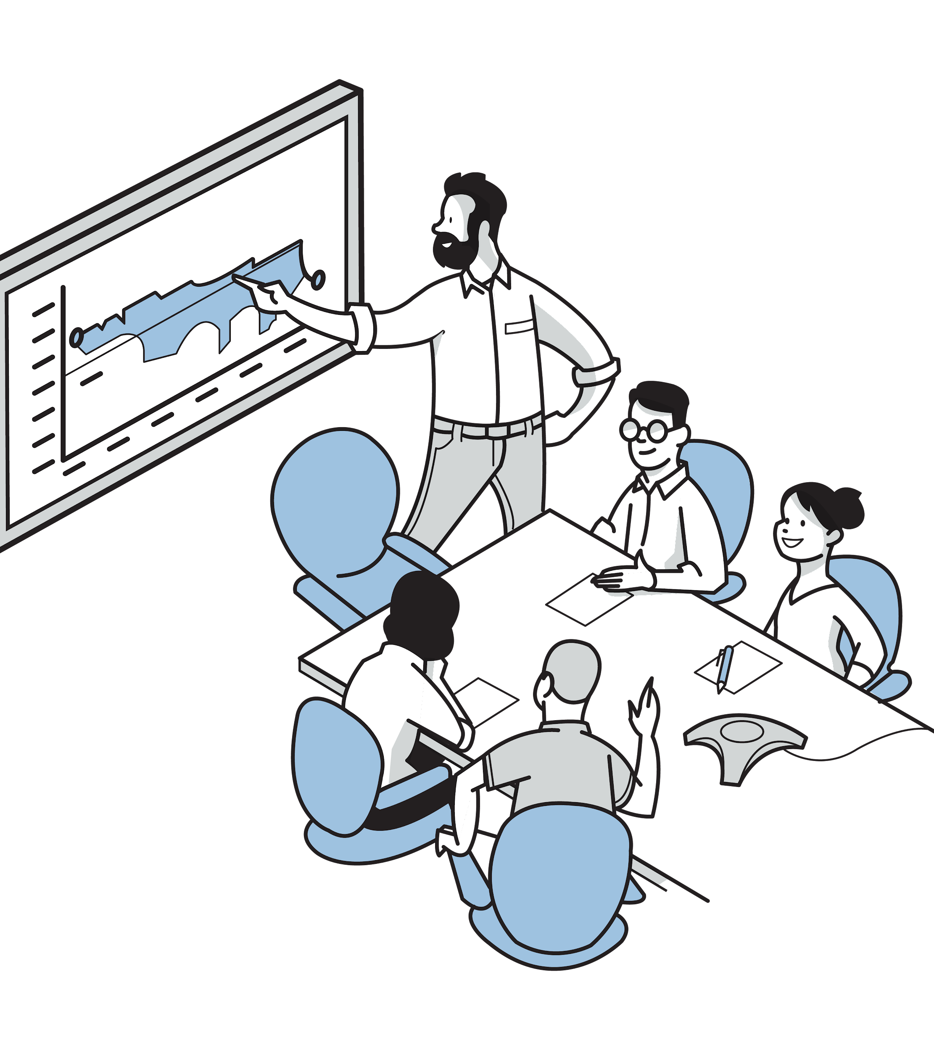
JOIN ONBOARDING
Your Join Project Team
[Input Name] - Join Project Admin
[Input Name] - PreCon Manager
[Input Name] - Sr. Estimator
[Input Name] - Join Champion
[Input Name] - Join Champion
Notes:
Adjust names and roles based on your core project team

Slide 6



JOIN REFRESHER
Join Overview
Join transforms the preconstruction experience by enabling the entire project team to drive decisions through shared information and real-time communication.

Slide 7

CORE FUNCTIONS
Where Join fits in the Preconstruction Process
Manage baseline estimates
Explore
estimate data
Get estimate and budget data into a new Join Milestone
Present
Pull unresolved Items into new Milestone
Propose and
manage items
Transition milestones
and reconcile items

Slide 8

CORE FUNCTIONS
Join Terminology
Milestone
A significant point in time that occurs during preconstruction and typically coincides with the issuance of a new drawing set. Milestones allow you to keep track of project estimates and budget.
Estimate
The original baseline estimate for the project in any given milestone. Items are considered as changes relative to this baseline estimate.
Budget
The target budget amount allocated for the project.
Markup
An indirect cost or below-the-line cost.
Item
Items are how Join allows you to track ideas to be explored or decisions to be made. Each item has a set of information to make it easy to brainstorm, analyze, and review an item.
Options
Options allow you to a range of mutually exclusive costs for an Item without artificially inflating or deflating the potential value of a project decision.
Notes:
If using project specific terminology update the

Slide 9
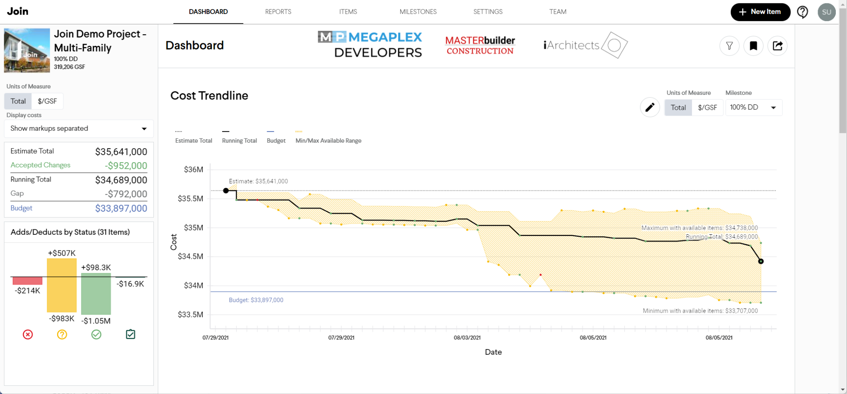
CORE FUNCTIONS
Dashboard
Project cost summary
The blue line is the project budget, while the black line shows the trendline as Items get accepted. The shaded area shows the cost range for the Items in this Milestone.
Item costs
by status

Slide 10
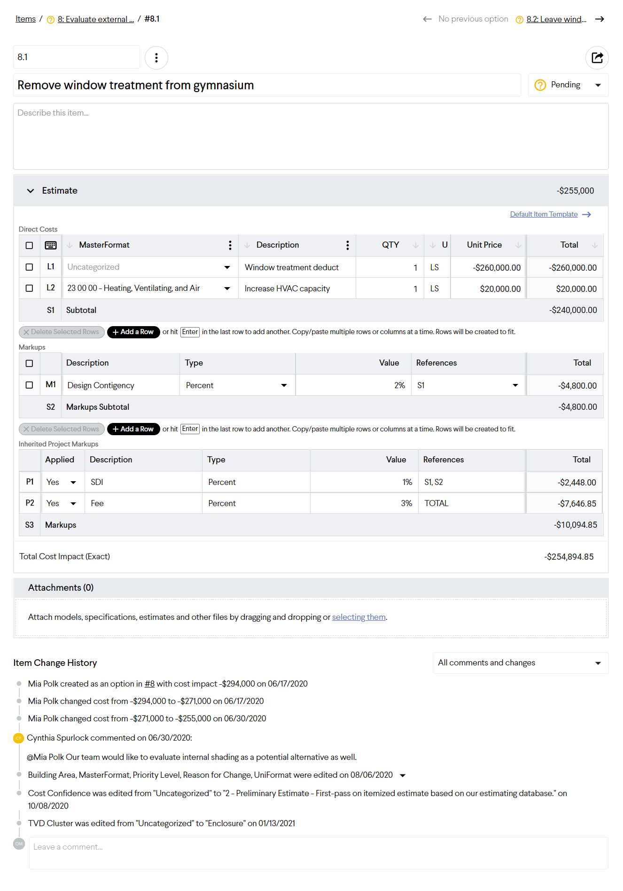
ITEM LIFECYCLE
Anatomy of an Item
Item metadata
Cost information
Supporting documentation
Audit log and comments

Slide 11









ITEM LIFECYCLE
Working with Items in Join
REVISED
IDEA/CHANGE
COST
DECISION
Pending
[Responsible Party]
Creates Item and adds basic info and assigns ownership
Pending
[Responsible Party]
Add detailed cost information and relevant models, drawings or specs
Accepted/Rejected
[Responsible Party]
Decision is made and meeting added, relevant info about decision added to comments
Incorporated
[Responsible Party]
Change added to the model and a new set of drawings is issued, change is included in the baseline estimate and future milestone
Notes:
Complete responsible parties and update actions if necessary

Slide 12


COMMUNICATION PLAN
Where to go for Help
?
‍
General Questions
Not sure how to do something in Join? Or want to know if you should use Join in for a certain situation?
Ask your Join Champions, they’ll have the information you need. If not they can always ask your Join Success team for backup.
Technical Support
Join is not working as you expected? Or you received an error message and you’re not sure what to do next?
Use the Contact Support form on the Join Success Hub and one of Join’s Support team will reach out to help.
Additional Learning
Want to learn more about Join? Or Need a refresher on what you learned last month?
Head on over to the Join Success Hub for short feature articles, videos and technical deep dives.
Feature Enhancements
Got ideas for how to make Join better? Or Wish Join did something that would make your day easier?
Join wants to hear them all. Submit ideas your ideas to the User Voice form. Join review and prioritize them regularly with our Join team.

Slide 13

ENSURE SUCCESS
Join’s Keys to Project Success
1. Create Your Join Account
Want to get a head start? Create your account by going to app.join.build, clicking Sign Up, and following the instructions.
2. Follow the Join Getting Started guide
Now you have your account setup, get familiar with Join using the Getting Started guide for your role.
3. Watch the Join Walkthrough
If you need an even more in-depth look at all aspects of Join. It also includes helpful tips for applying Join on our project.
4. Check out the Join Success Hub
Join provides an ever-growing set of resources, including helpful articles and educational videos, enabling users to find their way around Join and overcome any challenges they run face.

Slide 14
LET’S GET BUSY
Let’s Get This Project Started

Slide 15
Thank You!
Additional Resources
👷 Create your Join Account
🚀 Getting Started with Join
🎬 Introduction to Join
📚 Join Success Hub
💬 Join Technical Support

