Slide 1



WWW.JOIN.BUILD
Messaging Plan
1
Notes:
Standard cover

Slide 2

BEFORE WE START
Using This Resource
Welcome to Join 👋👋👋
We’re so excited you decided to Join us! We can’t wait to get you started making more transparent and accountable decisions with Join. With that said, this document and its linked resources are here to guide you on that journey to value alongside your Join Success team. Once you’ve personalized it to your specific needs, you can share it with your team to help them learn about Join and the rollout ahead.
We’ve set up this document to be easily personalized. Throughout, you’ll see italicized text like this that is designed to be instructional. Any text in brackets [ ] is intended to be changed with company-specific information, e.g. [Company Name]. You’ll also find guidance and talking points in the speaker notes.
Notes:
When you share this plan with your team, this slide can be removed.

Slide 3


TABLE OF CONTENTS
Join Overview
Today’s
Agenda
Onboarding with Join
Your Join Champions
Initial Project Rollout
What is Next
Keys to Success
Notes:
The “Today’s Agenda” slide is meant to be used for your office or company-wide rollout presentation. Topics include
Join Overview: What is Join and why are we using it?
Onboarding with Join:
Your Join Champions
Initial Rollout Plan
Communication Plan
Join’s Keys to Success

Slide 4


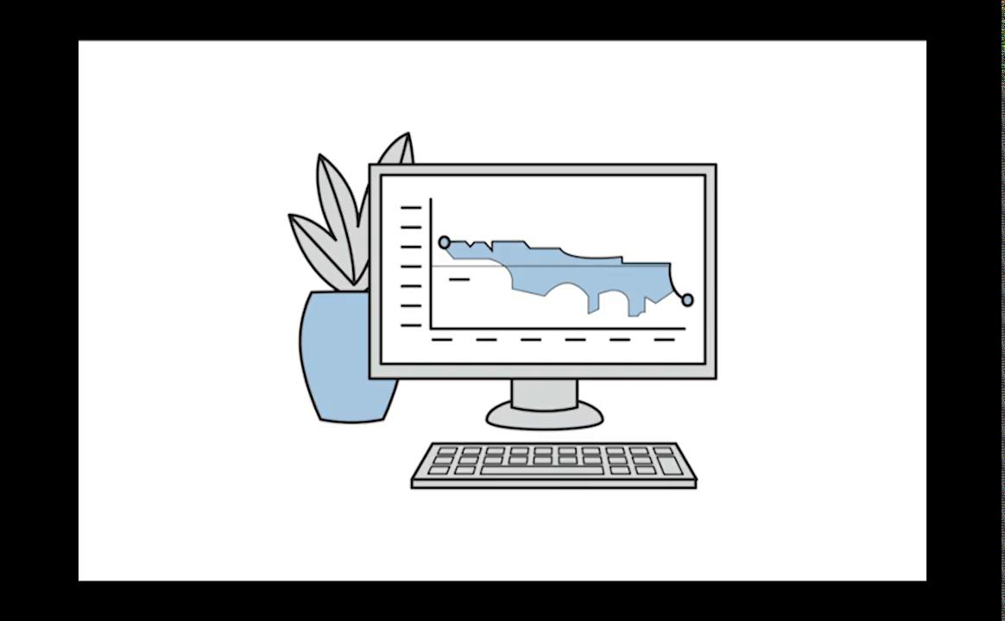
ABOUT JOIN
Join Overview
Join transforms the preconstruction experience by enabling the entire project team to drive decisions through shared information and real-time communication.

Slide 5
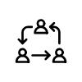

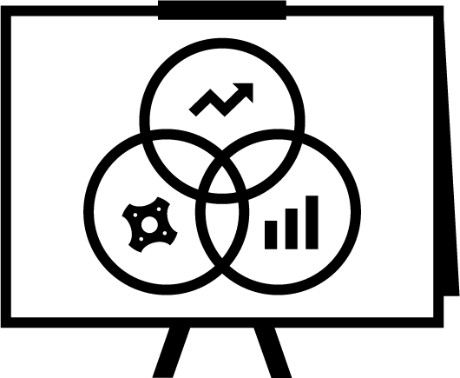


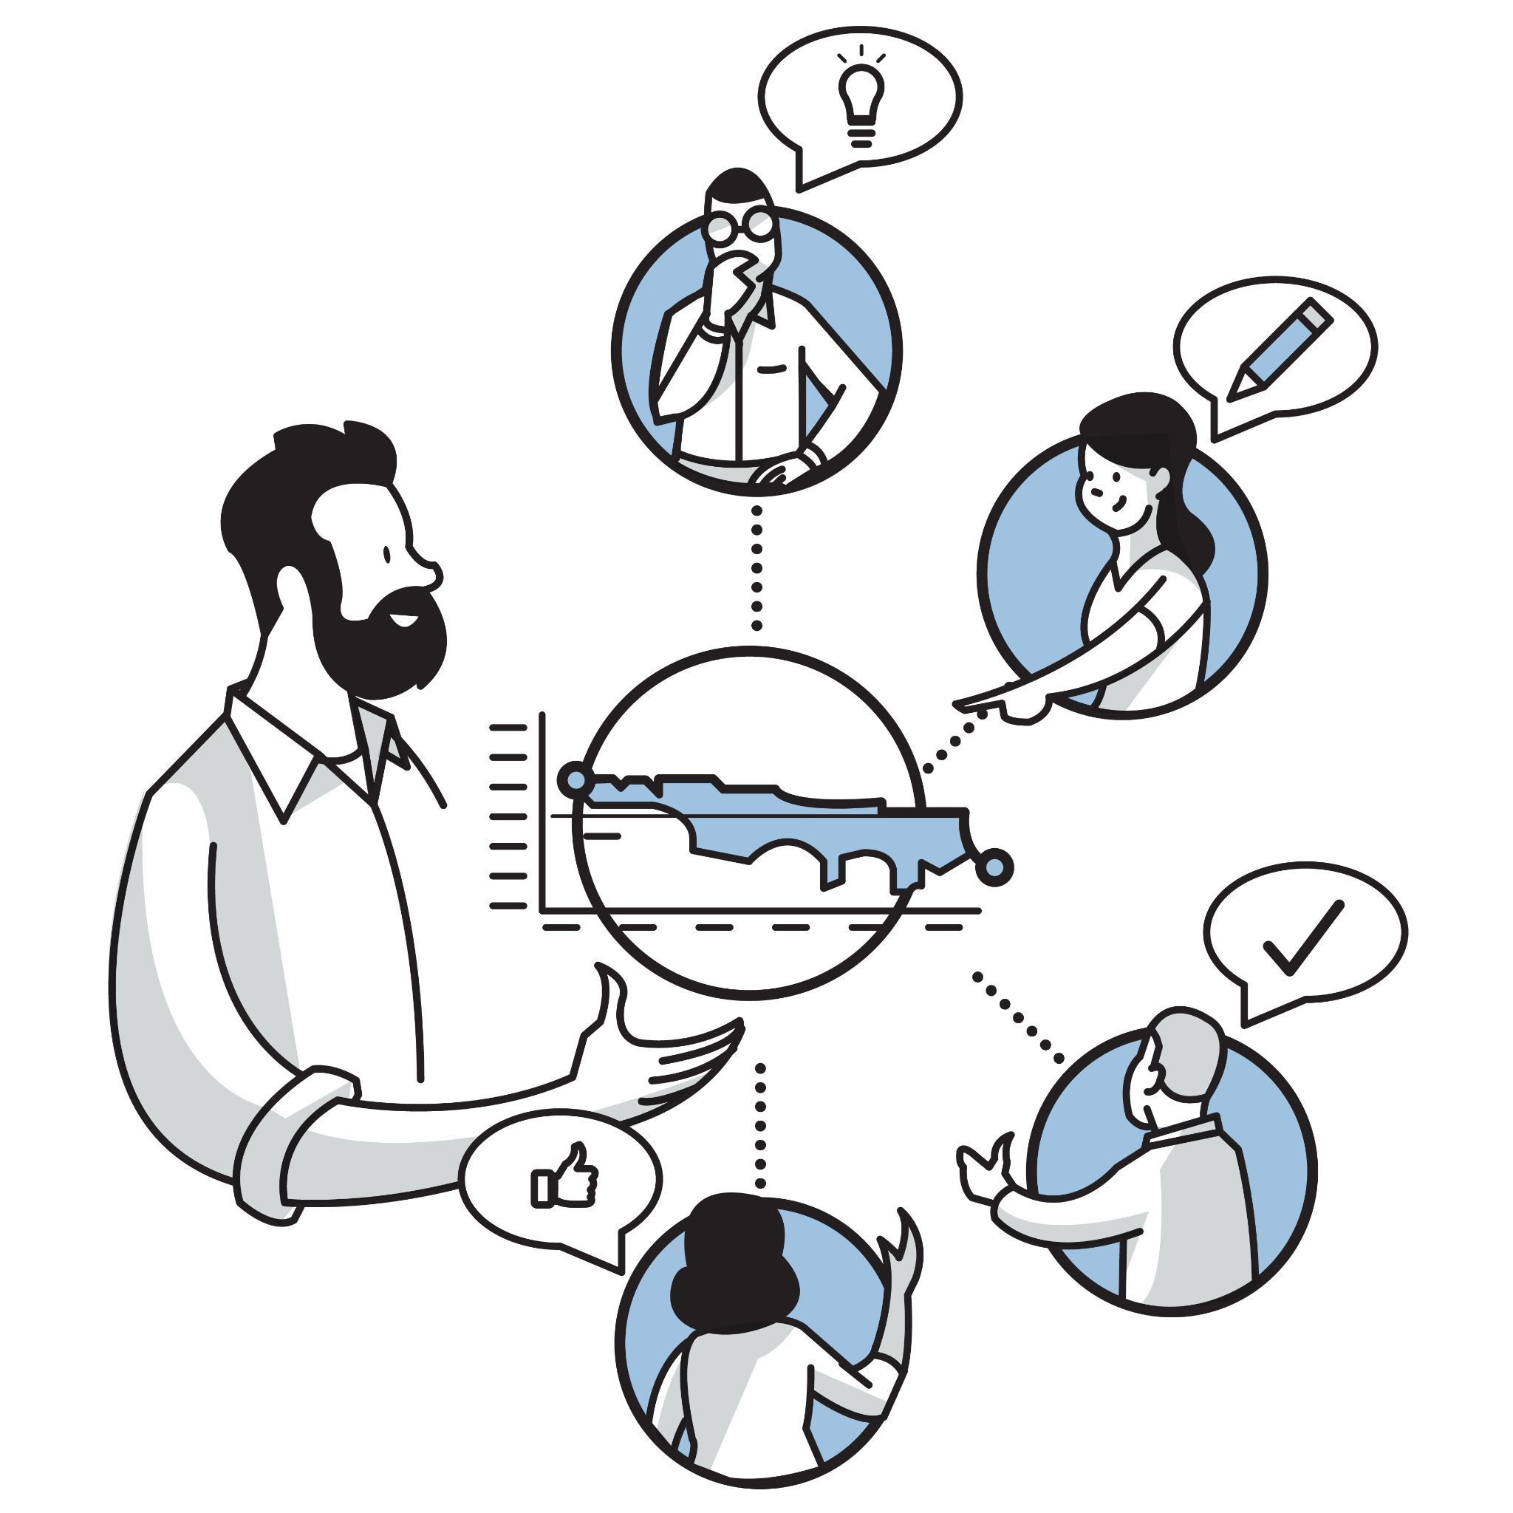
ABOUT JOIN
Join Overview
A single collaborative platform for the whole project team
Creates priceless trust with owners through transparency
Have confidence in presenting your data and options
Records for decision making and accountability
Saves countless hours wasted manipulating spreadsheets
Join transforms the preconstruction experience by enabling the entire project team to drive decisions through shared information and real-time communication.

Slide 6


The Problem
ABOUT JOIN
Join Overview
The Win
Building projects on budget and on schedule requires budget alignment and efficient decision making by the owner during preconstruction.
Laborious, manual, and error-prone Excel workflows for precon teams make it difficult to reflect real-time impacts, which slows down decision making.
Imagine owners making decisions in OAC meetings because all the information they need is readily available.

Slide 7


JOIN ONBOARDING
Background
[Company Name] has selected Join, the #1 preconstruction platform for project teams, to help guide your PreCon decisions and present trends with clarity and certainty to the project team.
Together, we’re embarking on a program to embed Join on projects throughout the organization.

Slide 8
JOIN ONBOARDING
How Join Will Help [Company Name]
Desired Outcome
Business Opportunity
1
[Problem 1]
[Opportunity 1]
2
[Problem 2]
[Opportunity 2]
3
[Problem 3]
[Opportunity 3]
Notes:
This slide is designed to be customized by your company in order to fit your unique Desired Outcomes and Business Opportunities. You can copy and paste these directly from your Kickoff meeting

Slide 9

JOIN ONBOARDING
Onboarding
Journey
1
Onboarding Kickoff
Alongside [Company Name]’s Join Account Manager, we’ve identified our Join Champions and outline our goals for using Join. We’ve determined the initial set of projects Join will be rolled out to and agreed on what types of projects should use Join going forward.
2
Learning & Consultation
Our Join Champions are empowered with the skills, knowledge, and confidence they need to ensure success on every project. They’ve walked through a project setup using our own real project data, supported by Join project experts.
Makes getting started with Join easier than the Sunday crossword
3
Initial Project Rollout
Leveraging Join’s implementation plan with support from the Join Champions, Join will be implemented on our identified projects. Our Join Account Manager will monitor our progress as we achieve our goals, and provide assistance and advice when needed.
4
Continued Adoption
Join is integrated as one of our primary tools for use on projects. We all understand when to use Join on a project, and the value it brings is clearly understood by all those involved, including project partners & Owners.
Notes:
Remind people you’ve already started this journey, more than likely you’re already in phase 3 or 4 by the time they’re seeing this

Slide 10
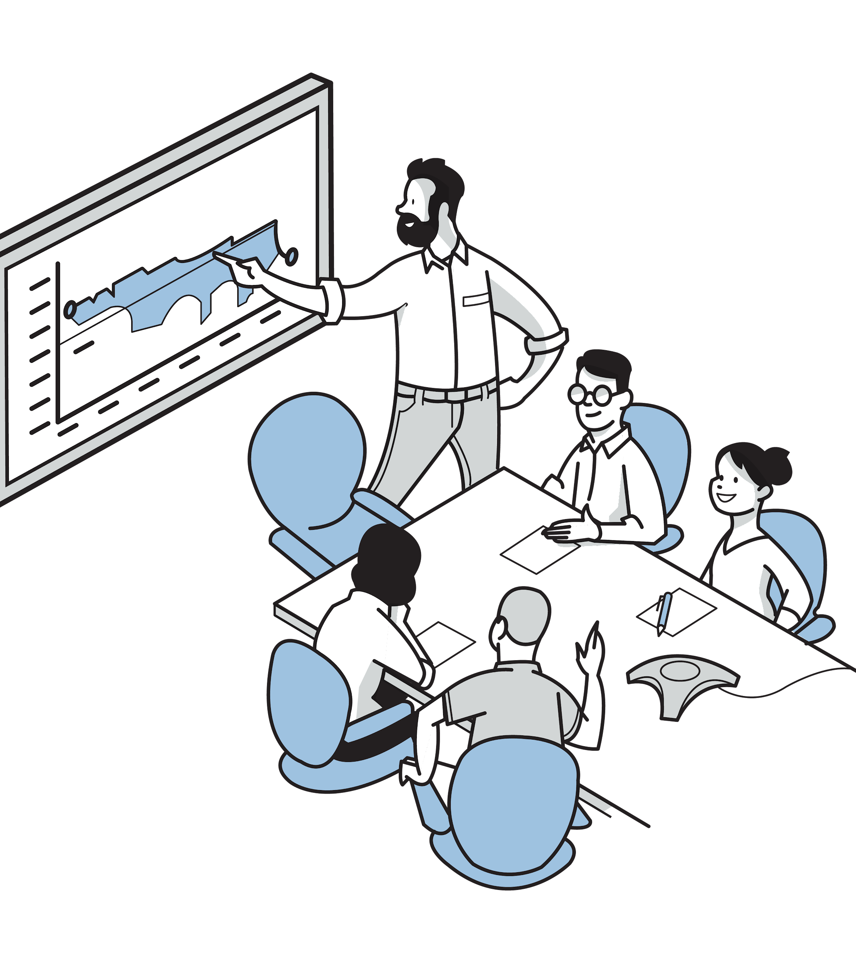
JOIN ONBOARDING
Your Join Team
[Insert Name] - Executive Sponsor
[Insert Name]- Join Lead
[Insert Name]- Join Champion
[Insert Name]- Join Champion
[Insert Name] - Join Champion
Executive Sponsor
Has a vested interest in seeing Join successfully rolled out across your organization, but will not be involved in the day-to-day activities of the onboarding.
Join Lead
Is responsible for moving the onboarding process forward and holds the Join Champions accountable. Serves as the primary point of contact for Join.
Join Champion
The critical resource for the success of Join within your organization. They will be responsible for actively participating in the onboarding process and becoming a Join product expert. They are accountable for driving adoption & providing guidance internally.
Notes:
Got a lot of Join Champions? Remove the image, if needed, to fit them all in.
It is important everyone is aware of the Join team and their various roles and responsibilities

Slide 11
JOIN ONBOARDING
Initial Project Rollout
Name: [Hospital Expansion]
Start Date: [October 2022]
Location: [Raleigh, NC]
Phase: [Active Project]
Type: [Health Care]
PreCon Manager: [Georgina Sullivan]
Name: [Fawlty Towers]
Start Date: [August 2022]
Location: [St. Louis, MO]
Phase: [Pursuit]
Type: [Multiuse]
PreCon Manager: [Steve McGuinness]
Name: [Join Headquarters]
Start Date: [April 2022]
Location: [Oakland, CA]
Phase: [Active Project]
Type: [Commercial]
PreCon Manager: [Lisa Walker]
In alignment with the Join Onboarding Plan, [Company Name] will roll out Join to strategically selected projects, where Join Champions are located, or motivated project teams exist. This will allow us to control, measure, and iterate on how Join is used on our projects without disrupting the wider group. Once Join has been successfully implemented on our initial projects, a broader rollout will follow to drive adoption across our team. The following projects have been identified as part of the initial rollout.
Notes:
Remove or update project types as necessary

Slide 12
COMMUNICATION PLAN
Rollout Schedule
[May]
[June]
[July]
Onboarding Kickoff
Champion Enablement
End User Training
[Project 1]
[Project 2]
[Project 3]
Notes:
Update your project names accordingly and adjust the dates and lines to meet your anticipated schedule. This isn’t designed to be set in stone with concrete dates but act as a guide so people know what is next

Slide 13


PROJECT QUICKSTART GUIDE
Get Your Project Up & Running in Hours
PRE-KICKOFF
PROJECT KICKOFF WORKSHOP*
1
2
INVITE TEAM & COLLABORATE
LEARN
ADD ESTIMATE
ADD CHANGE LOG
Self guided learning and familiarization with Join.
60-90 minutes of self-paced learning + exercises.
Import your first estimate into Join.
Compare estimate and budget easily.
Improved reporting.
Build out your change log in Join.
Real-time collaboration.
Improved decision-making.
Invite as many team members as suitable for project needs. Can be internal or owner, architect, and trades if applicable.
Alignment on project status.
Improved accountability.
Faster decisions.
✓
✓
✓
✓
✓
✓
✓
*Workshop is typically completed in 3-4 hours and is led by your Join Champions

Slide 14
COMMUNICATION PLAN
When to use Join
Pursuit Projects
Present early estimate concepts and value engineering possibilities to the owner with Join. Allowing you to build early trust with the owner and showcase future state real-time project collaboration.
Design Build/Assist, CMAR, and IPD
Use Join for continuous estimating and design/cost management at every stage of the project. Get the entire project team on board and increase clarity and accountability in the decision-making process.
Design-Bid-Build (traditional contract)
Join replaces your internal value engineering and changelog, delivering increased internal collaboration and transparency.
Notes:
Remove or update project types as necessary

Slide 15


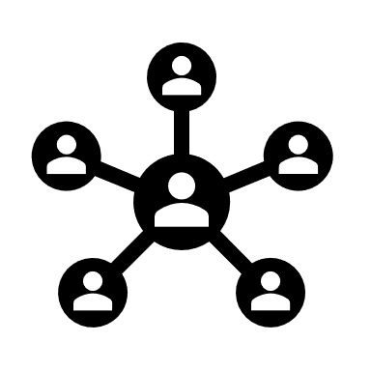

COMMUNICATION PLAN
Learning Approach
Champion Enablement
Designed to give [Company Name]’s Join Champions the knowledge, skills, and confidence they’ll need to support their teams in their adoption of Join.
Self Guided Content
Hands-on setup with real project data
Q&A with Join project experts
Getting Started
No matter what role you’re in, get up to speed with Join by following the Join Training Plan. You’ll get everything you need to get your job done in Join.
Self Guided Content
Role-based Self Guided Content
Project Kickoff
Join Champions lead Project Kickoff workshops to accelerate project setup. Project team members can self-onboard by following the Join Training Plan.
Led by Join Champions
Support from Join project experts
New Projects & Hires
As you win more work and add new team members don’t forget to set them up for success. Continue to leverage the Project Kickoff and Training Plan as needed.
Self Guided Content
Role-based Self Guided Content
Led by Join Champions

Slide 16



COMMUNICATION PLAN
Where to go for Help
?
‍
General Questions
Not sure how to do something in Join? Or want to know if you should use Join in for a certain situation?
Ask your Join Champions, they’ll have the information you need. If not they can always ask your Join Success team for backup.
Technical Support
Join is not working as you expected? Or you received an error message and you’re not sure what to do next?
Use the Contact Support form on the Join Success Hub and one of Join’s Support team will reach out to help.
Additional Learning
Want to learn more about Join? Or Need a refresher on what you learned last month?
Head on over to the Join Success Hubs Training Center for short feature videos and technical deep dives.
Feature Enhancements
Got ideas for how to make Join better? Or Wish Join did something that would make your day easier?
Join wants to hear them all. Submit ideas your ideas to the Customer Suggestion form.

Slide 17

ENSURE SUCCESS
Join’s Keys to Success
1. Get up to speed with Join Trainings
The Join Training Plan is designed to give you all the tools, knowledge, and confidence to be a Join expert in your role.
2. Get to know your Join Champion(s)
Your Join Champion(s) are your safety net to ensure your projects success in Join. They’ll be there to guide you and offer advice on how to use Join on your project to [Company Name]’s standards.
3. Use Join as part of your next RFP
Want to differentiate yourself on your next project, and win more work? Use Join in the Pursuit phase to showcase how invested you are in their project and establish a edge over your competition.
4. Check out the Join Success Hub
Join provides an ever-growing set of resources, including helpful articles and educational videos, enabling users to find their way around Join and overcome any challenges they run face.

Slide 18
Thank You!
Additional Resources
📺 Join Introduction (5 mins)
🚀 Getting Started with Join
🎬 Join Walkthrough (37 mins)
📢 Project Quickstart Guide
📚 Join Success Hub
💬 Technical Support

