Slide 1
Join
Interview Slides

Slide 2
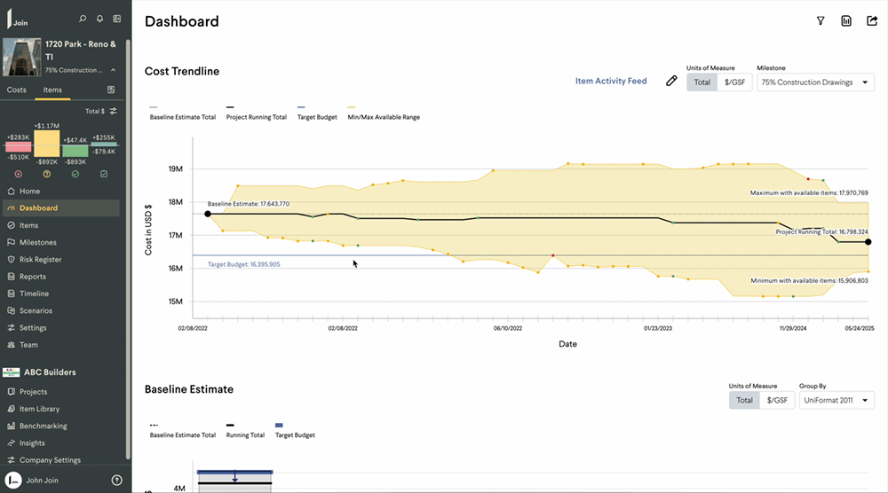



Visualize cost trends
Cost Trendline
Instant understanding of project status
Real-time updates
Accurate cost roadmap
A clear view of how we are mitigating risk and controlling cost
Notes:
The dotted black line at the top is the baseline estimate.
The jagged black line in the middle is the running total.
The solid blue line at the bottom is the owner’s target budget.
The yellow area represents the available range for decisions still on the table. The dots above the running total (jagged line) are items that would add to the budget; the dots below are items that would reduce the budget.
Green dots are accepted items, yellow dots are pending items.
Cost Trendline is a live report that owners can access 24/7 to understand where their budget is tracking in real time.
It shows the cost implications of decisions in real time.

Slide 3
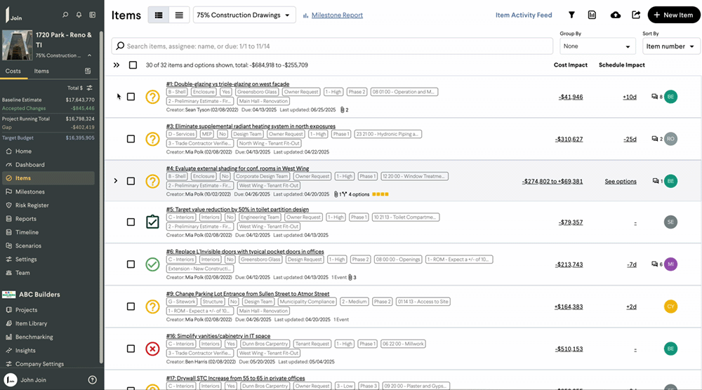



Collaborate and track decisions
Items
Clear account of the decisions on the table
See cost/schedule impact
Track accountability, decision history
Real-time collaboration to maximize value through decisions
Notes:
Items are potential decisions in an active milestone. The items list replaces Excel for value analysis.
Items are either additive or deductive and have cost impacts and schedule impacts.
Items can have hyperlinks to specs and other documentation.
Items can also have options.
The GC, architect, and owner collaborate in real-time or asynchronously on items.
Above, the red x represents a rejected item; yellow question mark represents a pending item; green check shows an accepted item; dark green check represents an incorporated item.

Slide 4
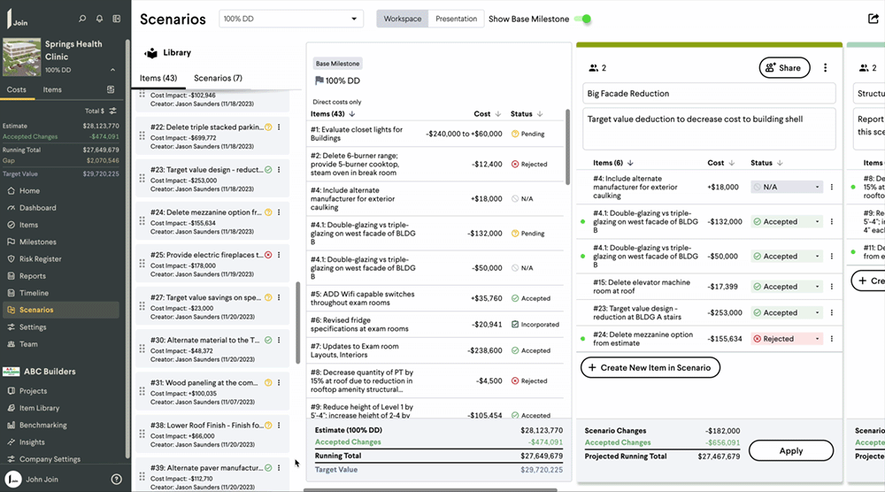



Evaluate scenarios
Scenarios
See implications of decisions
Choose data-based options
Move project forward
A virtual sandbox for evaluating groups of options
Notes:
Scenarios is a virtual sandbox where teams can play with ideas.
Team members drag and drop Items to create different Scenarios.
Owners can compare multiple design or scope options side by side, including their cost implications and schedule impacts.
They can review various combinations of cost-saving measures and choose the one that best balances value and performance.
Owners can also lock in the most cost-effective path forward by clearly seeing the budget implications of each action.

